Slide 1

Applied Physics For Engineers (PHY-121)
CIIT, Attock
Lecture 01: Introduction

Slide 2
Contact Details
CIIT, Attock
Office Address:
Room in DLD Lab
ECE Block,
COMSATS University, Attock
Office Timings:
8:30 am to 4:30 pm
Monday to Friday
Email Address:
Kashif.Jatoi@ciit-attock.edu.pk

Slide 3
Books
CIIT, Attock
Text Book / Essential Reading:
1. Electric Circuits 2nd Edition Theodore F. Bogart, Jr.
2. Applied physics by Resinick and halliday.
3. Unviersity Physics by Young and freedman 13th edition
Reference Books / Literature:
Fundamentals of Electric Circuits 3rd Edition Charles K. Alexander, Matthew N. O. Sadiku
MOST IMPORTANT: PLEASE TAKE LECTURE NOTES DURING CLASSES

Slide 4
Course Structure
CIIT, Attock
Total Credit Hours: 04
Lectures Credit Hours: 03
Lab. Credit Hours:01
Total Contact Hours:06
Lecture Contact Hours:03
Lab. Contact Hours:03

Slide 5
Marks Distribution
CIIT, Attock
Quizzes 15 Marks (No Re-Quiz Request will be entertained)
Assignments 10 Marks (No late Assignments will be accepted)
Mid-term 25 Marks
Final Exam 50 Marks
Note : There will be total 4 Quizzes and 4 Assignments but the number of quizzes and assignments may increase.

Slide 6
Intro to APFE
CIIT, Attock
Objectives:
By the time this course is completed, a student should:
Describe basic concepts related to Electric Charge, Coulombs law, Electric field and intensity, Voltage, Power & Energy, Current, Digital Multimeter, Voltmeter, Ammeter, & Ohmmeter, SI Unit, Ohm’s Law.
Analyze series/parallel DC circuits with resistors. Application of Voltage, Current Divider, Kirchoff’s Laws
Basics of electricity, magnetism etc.

Slide 7
Systems of Units
CIIT, Attock
There are 3 commonly used unit systems.
English (used in the United States, UK)
Metric
SI (most formal version of Metric used in science)
SI (System International)
In 1960 General conference of Weights and Measures was held in France.
US endorsed the use of SI units by passing the Metric Conversion Act in 1975.
The basic 5 of 7 Base units are:
Meter (length), Kilogram (mass), Second (time), ampere (current), kelvin (temp)

Slide 8
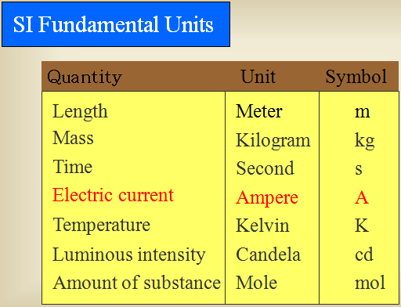
CIIT, Attock

Slide 9
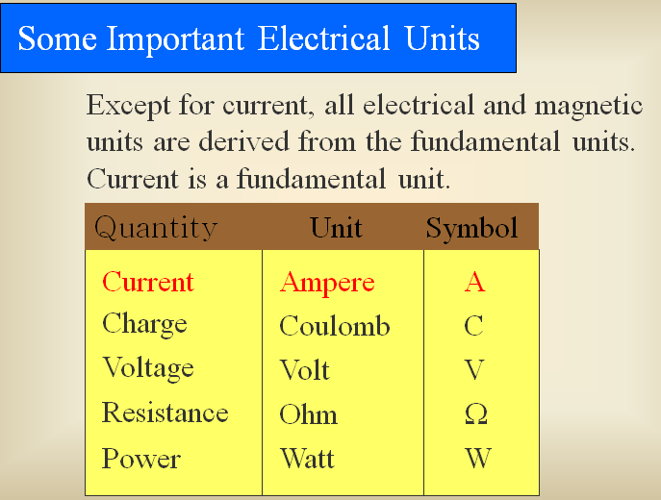
CIIT, Attock

Slide 10
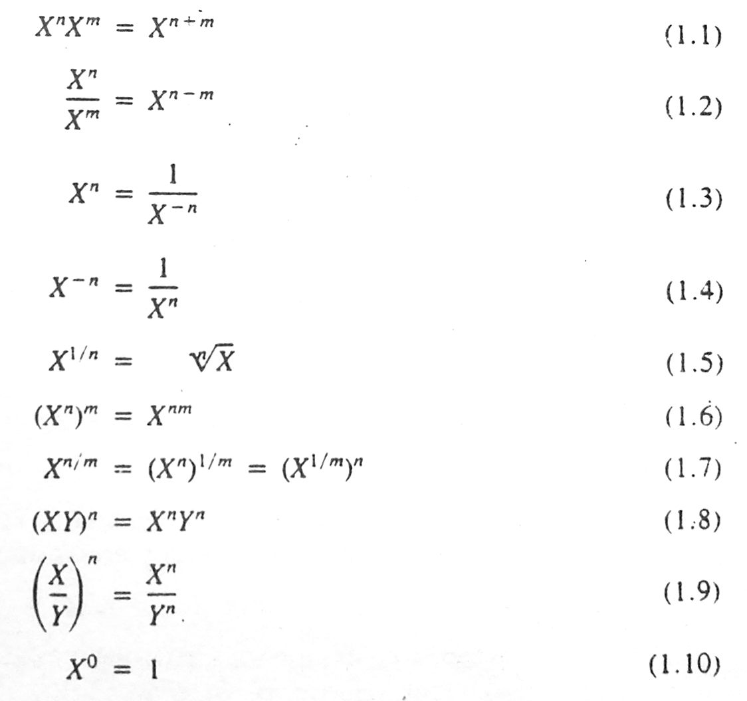
Review of Exponents
CIIT, Attock

Slide 11
Practice!
CIIT, Attock

Slide 12
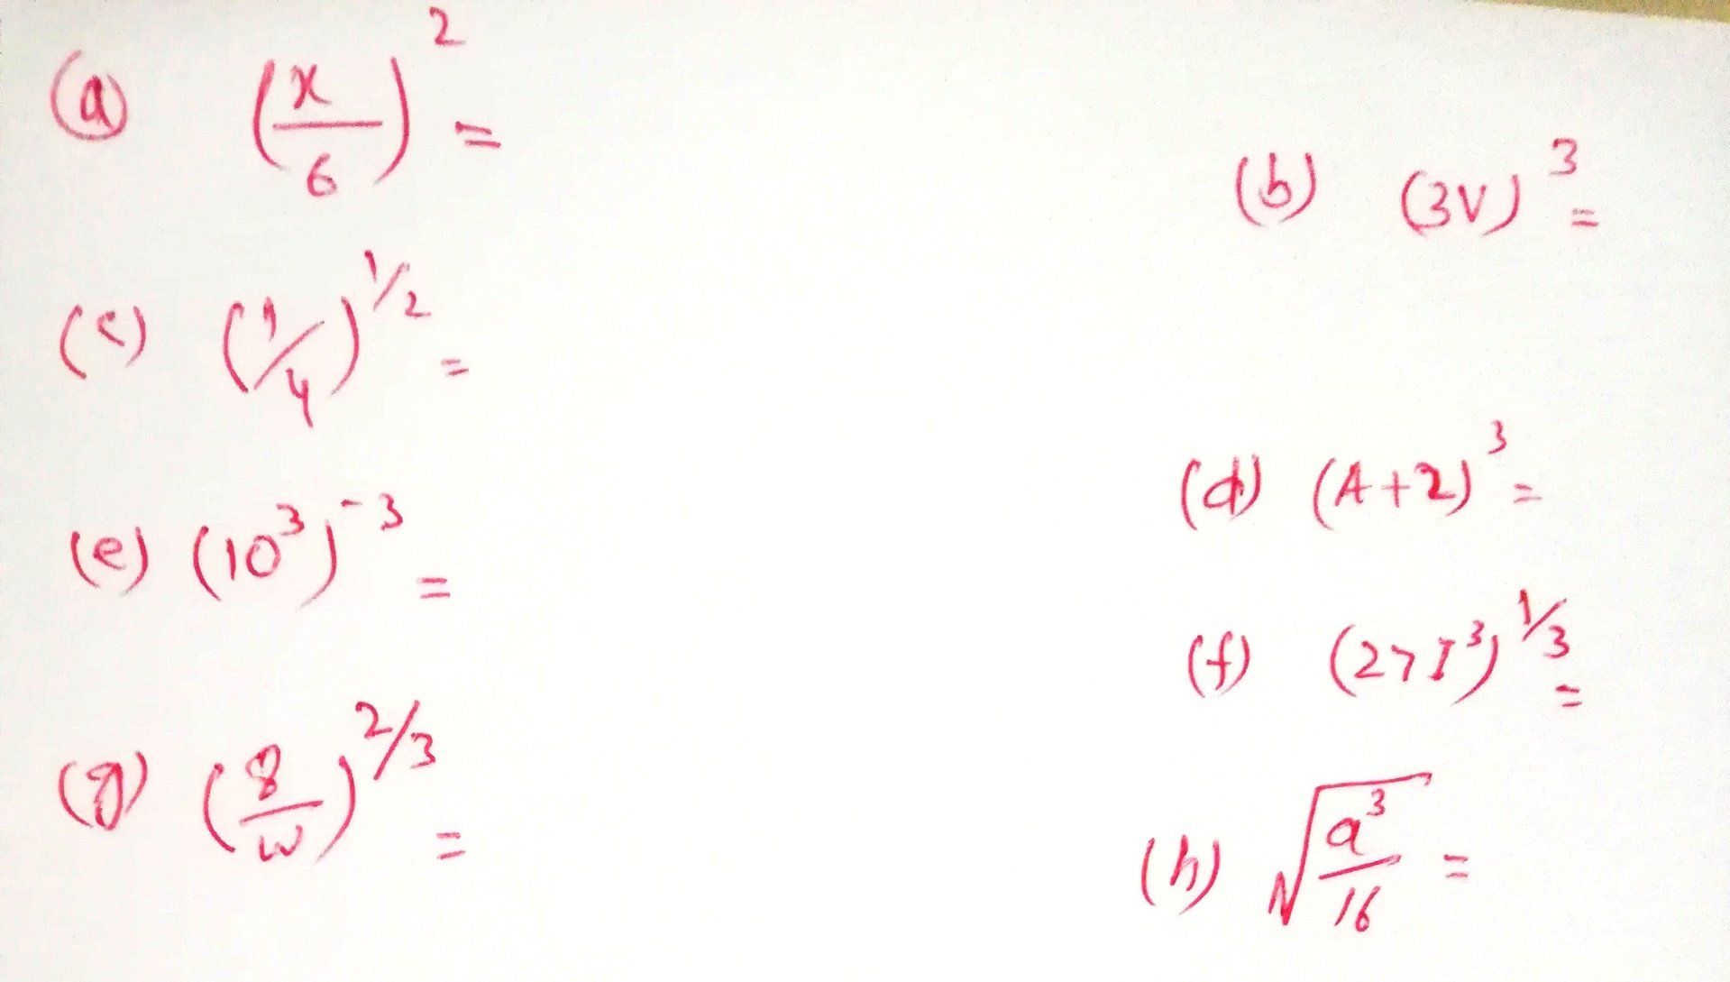

Slide 13
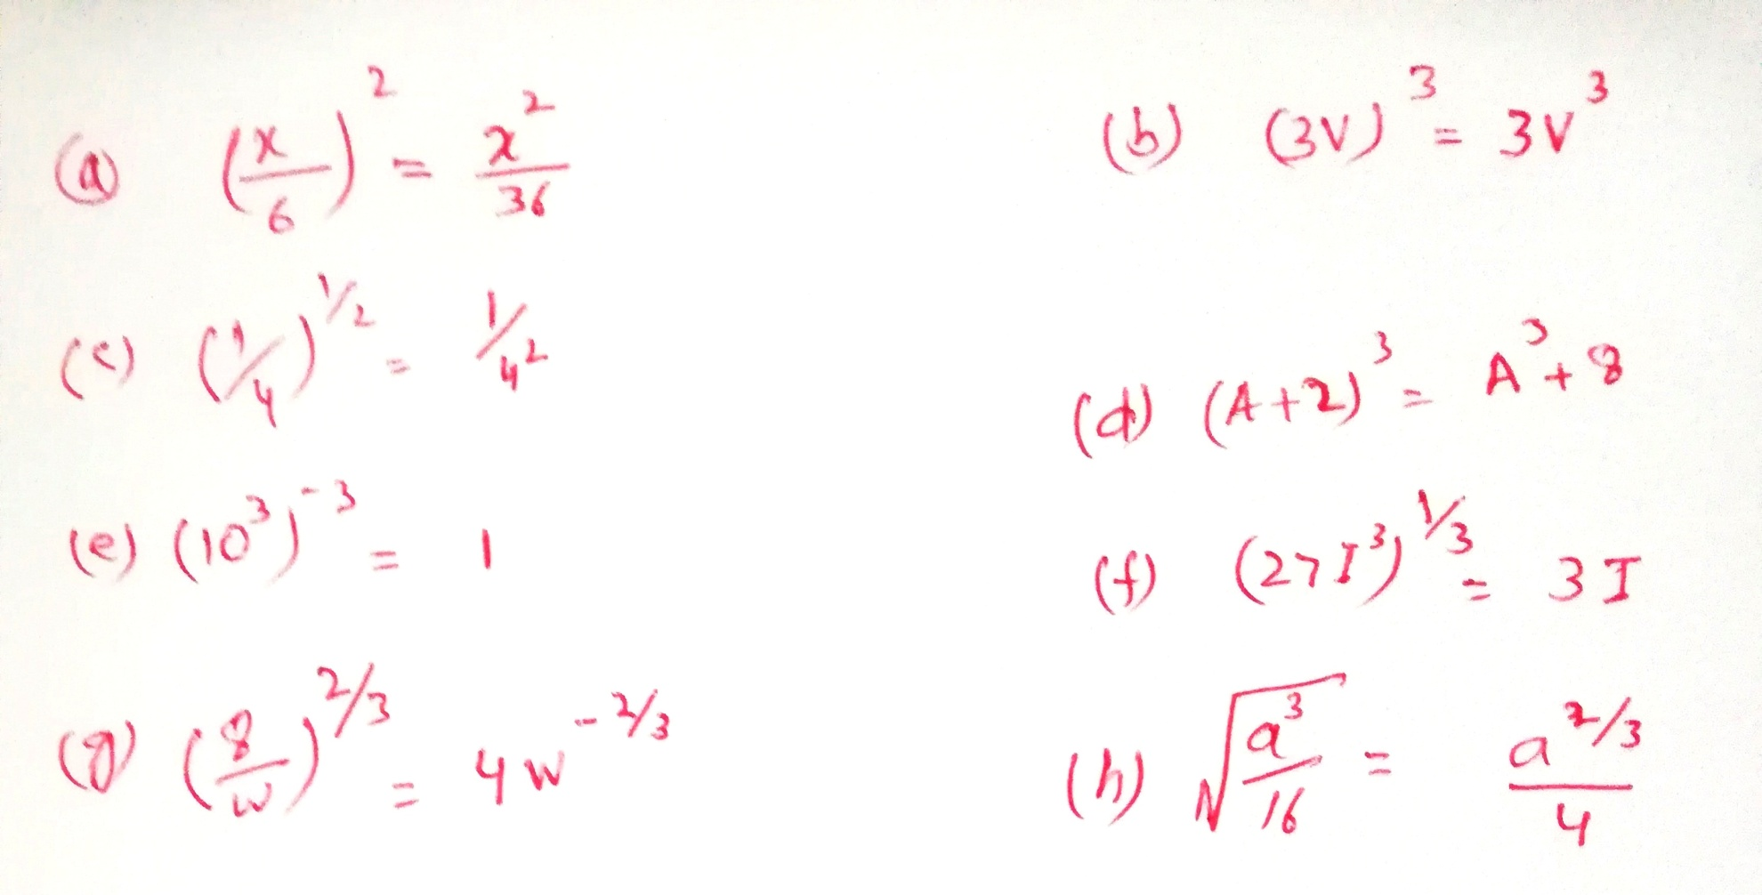

Slide 14
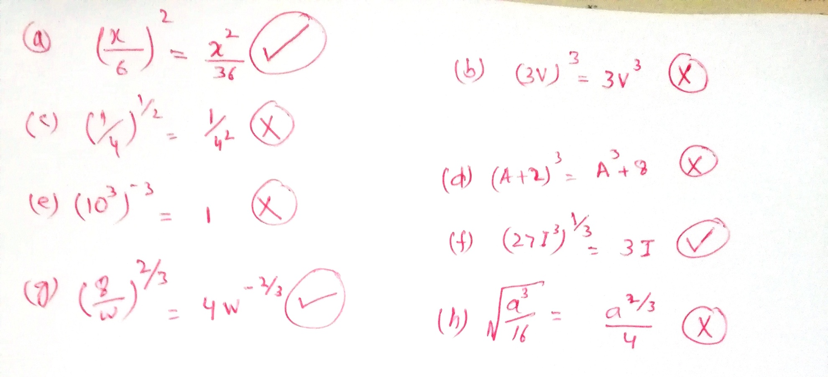

Slide 15
